Slide 1


Kalaiveni
DEC,2023

Slide 2

Outline
Executive Summary
Introduction
Methodology
Results
Conclusion
Appendix

Slide 3
Executive Summary
Summary of methodologies
Data Collection from API and Web scraping.
Data Wrangling
Exploratory Data Analysis (EDA) using SQL, Pandas and Matplotlib.
Interactive Visual Analytics and Dashboard with Folium and Plotly Dash.
Predictive Analysis (Classification).
Summary of all results
The best Hyperparameters for Logistic Regression, SVM, Decision Tree and KNN classifiers.
The method that performs best using test data.

Slide 4
Introduction
SPACE Y is here to compete in the commercial space race. We are making rocket launches relatively inexpensive for everyone. SPACE Y can save millions in every launch of our Eagle rocket because we can reuse it's first stage.
To determine if the first stage of our competitor will land and determine the cost of a launch by using Data Science and Machine Learning models.

Slide 5

Section 1

Slide 6

Methodology
Executive Summary
Data collection methodology:
Data is gathered from SPACE REST API Data wrangling and web scraping.
Perform data wrangling
Data is collected from JSON and HTML tables and converted to Pandas Dataframe for visualization and analysis
Perform exploratory data analysis (EDA) using visualization and SQL
Perform interactive visual analytics using Folium and Plotly Dash
Perform predictive analysis using classification models
Using Machine Learning to determine if first stage of Falcon 9 will land successfully

Slide 7
Data Collection
Data is gathered from SPACE REST and web scraping
SPACE REST API endpoint
Get Request using request library
GET past launch as JSON Object
Convert JSON to Dataframe
Webscraping FALCON 9 Launch record
Use BeautifulSOup to web scrape HTML Table
Parse data from table
Convert table to Data frame

Slide 8
Data Collection – SpaceX API
Data collection from the SPACE API
Data collection API
SPACE REST API endpoint
Get Request using request library
GET past launch as JSON Object
Convert JSON to Dataframe
Filter dataframe to include only Falcon 9 launces
Extract information from booster name,launch site,payload mass and landing site
Deal with missing Values
Data wrangling

Slide 9
Data Collection - Scraping
Perform web scraping to collect Falcon 9 historical launch records
Web scraping GITHUB URL
Request the Falcon 9 Launch wiki page
BeautifulSoup object from the response
Extract column names from HTML table headers
Create Dataframe by Parsing the launch HTML tables
Data Wrangling

Slide 10
Data Wrangling
EDA is used to find patterns in the data and determine label
GitHub URL
Identify missing data
Identify numerical and categorical column
Calculate number of launches on each site
Calculate number and occurrence of each orbit
Calculate number and occurrence of mission outcome per orbit type
Create landing outcome label from outcome column

Slide 11
EDA with Data Visualization
Summary of charts that were plotted
Catplot to visualize the relationship between Flight Number and Payload
Catplot to visualize the relationship between Flight Number and Launch Site.
Catplot to visualize the relationship between Payload and Launch Site.
Bar chart to visualize the relationship between success rate of each Orbit type.
Catplot to visualize the relationship between Flight Number and Orbit type.
Catplot to visualize the relationship between Payload and Orbit type.
Line chart to visualize the launch success yearly trend
EDA with data visualization notebook.

Slide 12
EDA with SQL
SQL queries performed:
Display the names of the unique launch sites in the space mission:
SELECT DISTINCT(launch_site) FROM SPACEXTBL
Display 5 records where launch sites begin with the string 'CCA’:
SELECT FROM SPACEXTBL WHERE launch site LIKE 'CCA% LIMIT 5
Display the total payload mass carried by boosters launched by NASA (CRS):
SELECT SUM(payload_mass kg) AS TOTAL PAYLOAD MASS FROM SPACEXTBL WHERE customer 'NASA (CRS)
Display average payload mass carried by booster version F9 v1.1:
SELECT AVG(payload mass_kg) AS AVG PAYLOAD MASS FROM SPACEXTBL WHERE booster_version='F9 v1.1’:
List the date when the first successful landing outcome in ground pad was achieved:
SELECT MIN(DATE) AS first_successful_landing FROM SPACEXTBL WHERE (landing outcome)=Success (ground pad)

Slide 13
EDA with SQL
SQL queries performed:
List the names of the boosters which have success in drone ship and have payload mass greater than 4000 but less than 6000:
SELECT booster version, payload mass kg, landing outcome FROM SPACEXTBL WHERE landing_outcome Success (drone ship) AND (payload mass kg BETWEEN 4000 AND 6000)
List the total number of successful and failure mission outcomes:
SELECT mission outcome, COUNT(mission outcome) AS TOTAL FROM SPACEXTBL GROUP BY mission outcome
List the names of the booster versions which have carried the maximum payload mass. Use a subquery:
SELECT DISTINCT(booster_version) (SELECT MAX(payload mass kg) AS "maximum payload mass" FROM SPACEXTBL) FROM SPACEXTBL LIMIT
, EDA with SQL notebook

Slide 14
Build an Interactive Map with Folium
Summary of map objects that were created and added to the Folium map
folium.Circle and folium.Marker to add a highlighted circle area with a text label on a specific coordinate for each launch site on the site map.
MarkerCluster object for simplify a map containing many markers having the same coordinate.
MousePosition on the map to get coordinate for a mouse over a point on the map.
folium.PolyLine object to draw a line between a launch site to its closest city, railway and highway.
GitHub URL-interactive map with Folium map

Slide 15
Build a Dashboard with Plotly Dash
Summary of plots/graphs and interactions that were added to the dashboard to perform interactive visual analytics on SpaceX launch data in real-time.
This dashboard application contains input components such as a dropdown list and a range slider to interact with a pie chart and a scatter point chart.
A launch Site Drop-down Input Component. There are four dinferent launch sites and a dropdown menu let us select different launch sites.
A callback function to render success-pie-chart based on selected site dropdown.The general idea of this callback function is to get the selected launch site from site-dropdown and render a pie chart visualizing launch success counts.
A range Slider to Select Payload.The Slider is to be able to easily select different payload range and see if we can identify some visual patterns.
A callback function to render the success-payload-scatter-chart scatter plot. To visually observe how payload may be correlated with mission outcomes for selected site(s).
GitHub URL

Slide 16
Predictive Analysis (Classification)
Summary of the model development process used to predict if the first stage will land given the data from the preceding labs
Predictive Analysis
Data load: dataset_part2.csv and dataset_part3.csv
Variable Y from Column class using dataset_part2.csv
Variable X creation using features_one_hot dataframe from dataset_part3.csv
Train_test_split to split the data into training and test data
Creation of Logistic regression,svm,decision tree,Knn,GridsearchCV obj
Best Parameter,accuracy,confusion matrix
Selecting best method

Slide 17
Results
Exploratory data analysis results
Interactive analytics demo in screenshots
Predictive analysis results

Slide 18

Section 2

Slide 19
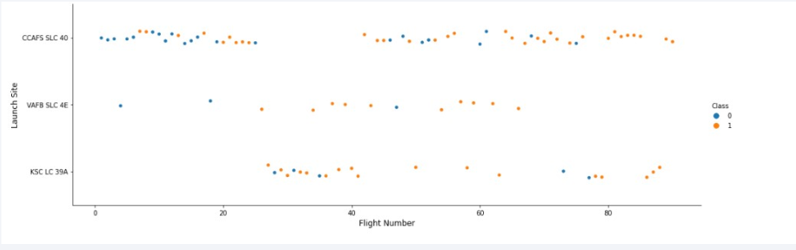
Flight Number vs. Launch Site
With time the successful rate has increased for every Launch Site, especially for CCAFS SLC 40, where are concentrated the majority of the launches.
VAFB SLC 4E and KSC LC 39A has a higher successful rate but represents one third of the total launches

Slide 20
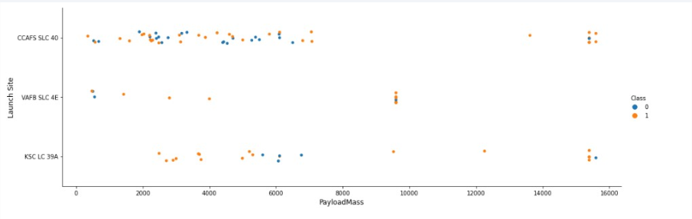
Payload vs. Launch Site
In VAFB-SLC launch site there are no rockets launched for heavy payloadmass (greater than 10000 kg).
In KSC LC launch site there are no rockets launched for lower payloadmass (less than 2500kg).
CCAFS SLC has launched rockets less than 7500kg and more than 13000kg payloadmass but not in between.

Slide 21
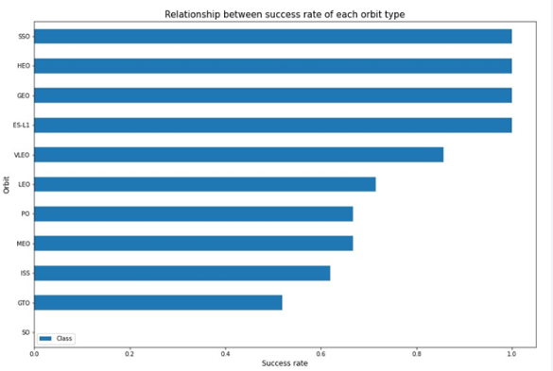
Success Rate vs. Orbit Type
First orbit types has best successful rate

Slide 22
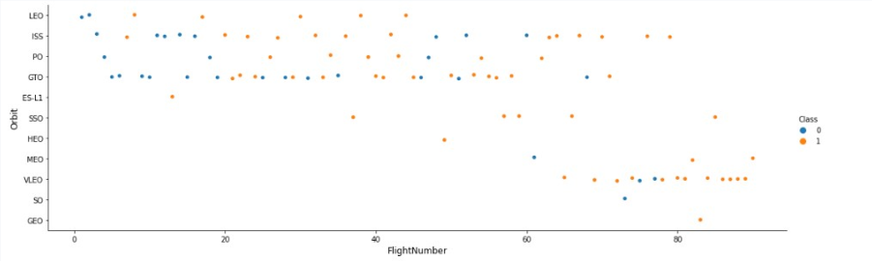
Flight Number vs. Orbit Type
As expected, there are more failures at the beginning of the series of launches, but, after the first 40 launches, the ratio improves by reducing the 50 percent of unsuccessful landings.
GTO and ISS orbits has the higher concentration of launches with the lowest ratio of successful landings.
The orbits with higher successful rate, has one or just a few number of launches.

Slide 23
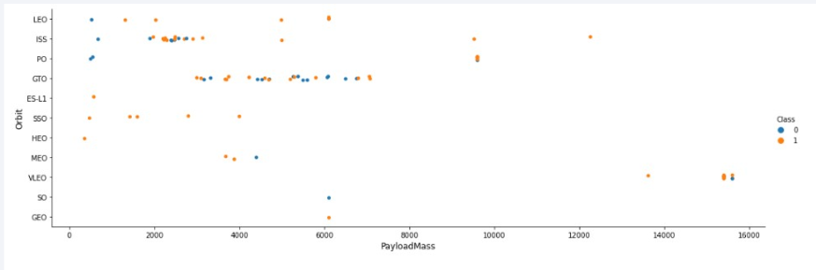
Payload vs. Orbit Type
Exists a visible limit of Payload around 7600 kg. Less than 10 launches exceed that limit.
With heavy payloads the successful landing rate are more for Polar, LEO and ISS.
However for GTO, we cannot distinguish this well as both, positive landing rate and negative landing are both there here

Slide 24
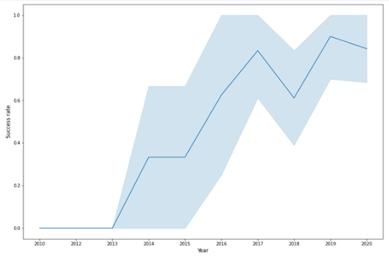
Launch Success Yearly Trend
Success rate increases from 2013 to 2020

Slide 25
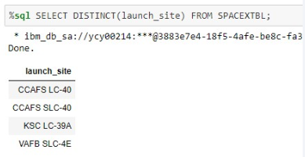
All Launch Site Names
4 unique launch sites in space mission

Slide 26
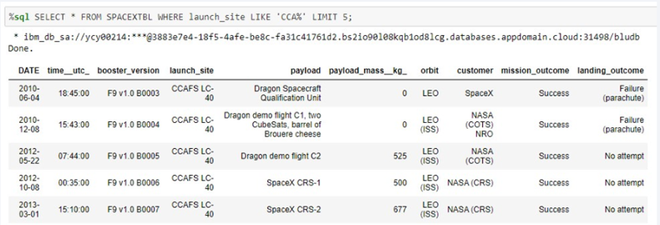
Launch Site Names Begin with 'CCA'
Find 5 records where launch sites begin with `CCA`
Query uses WHERE ,LIKE and LIMIT

Slide 27
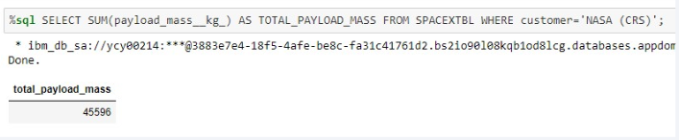
Total Payload Mass
Calculate the total payload carried by boosters from NASA
Query uses SUM and WHERE

Slide 28
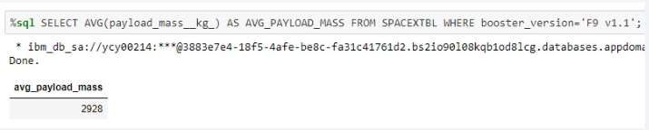
Average Payload Mass by F9 v1.1
Calculate the average payload mass carried by booster version F9 v1.1
Query uses AVG and WHERE

Slide 29
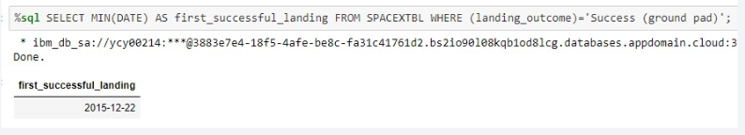
First Successful Ground Landing Date
Find the dates of the first successful landing outcome on ground pad
Query uses MIN and WHERE

Slide 30
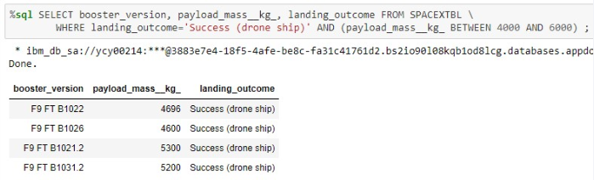
Successful Drone Ship Landing with Payload between 4000 and 6000
Names of boosters which have successfully landed on drone ship and had payload mass greater than 4000 but less than 6000 using WHERE and AND .

Slide 31
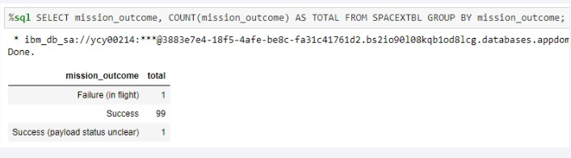
Total Number of Successful and Failure Mission Outcomes
Total number of successful and failure mission outcomes
Query uses COUNT and GROUP BY

Slide 32
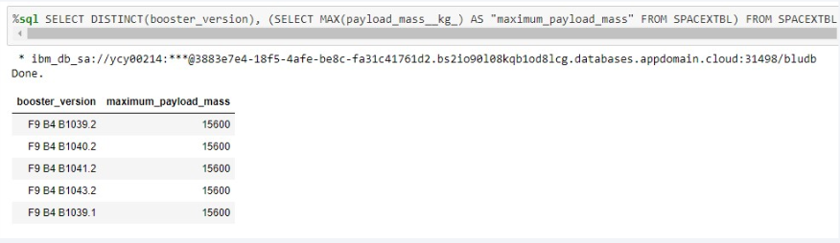
Boosters Carried Maximum Payload
List the names of the booster which have carried the maximum payload mass
Query uses DISTINCT

Slide 33
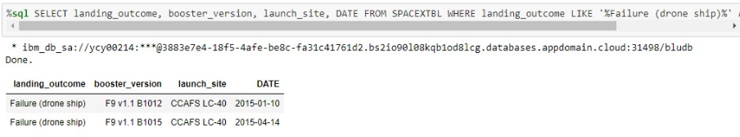
2015 Launch Records
List the failed landing_outcomes in drone ship, their booster versions, and launch site names for in year 2015
Query uses WHERE and LIKE

Slide 34
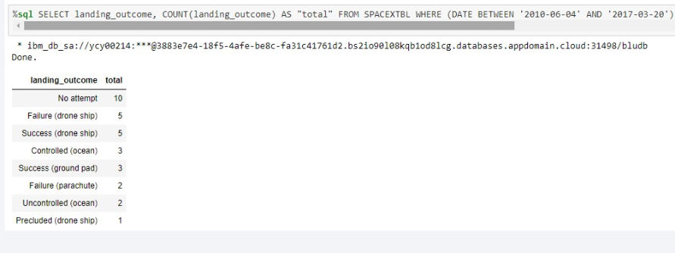
Rank Landing Outcomes Between 2010-06-04 and 2017-03-20
Rank the count of landing outcomes (such as Failure (drone ship) or Success (ground pad)) between the date 2010-06-04 and 2017-03-20, in descending order
Query uses COUNT ,WHERE and AND

Slide 35

Section 3

Slide 36
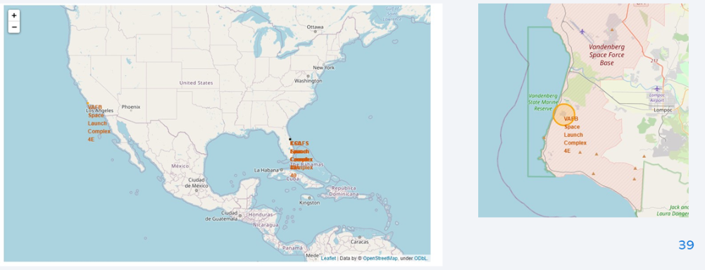
Launch Sites
All launch sites are in close proximity to coast and into restricted area

Slide 37
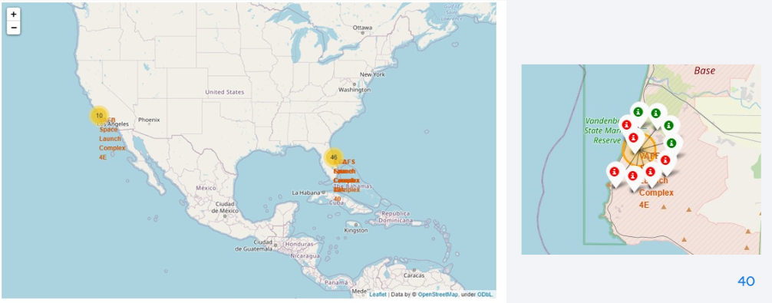
Map1:Clusters for all launch sites
Map2:Green marker-if launch is success.Red-If launch fails

Slide 38
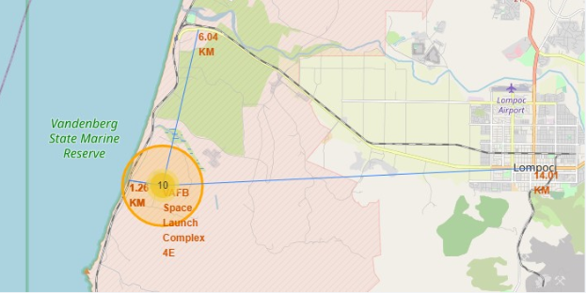
Launch site and Proximity
Launch sites are near to railway ,road highways and coastline

Slide 39

Section 4

Slide 40
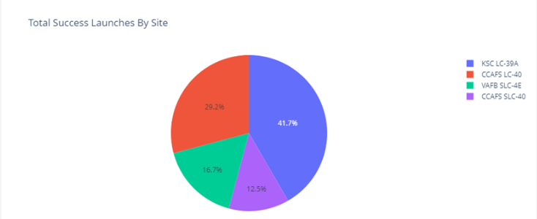
Total success launch by site
KSC LC 39A , site with highest launch success

Slide 41
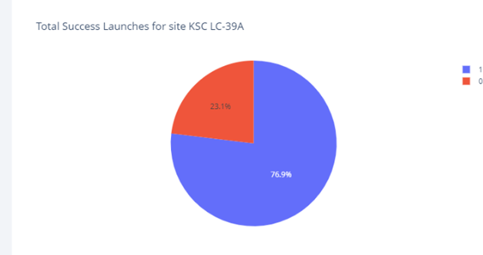
KSC LC -39A
Pie chart of KSC LC 39A , site with highest launch success

Slide 42
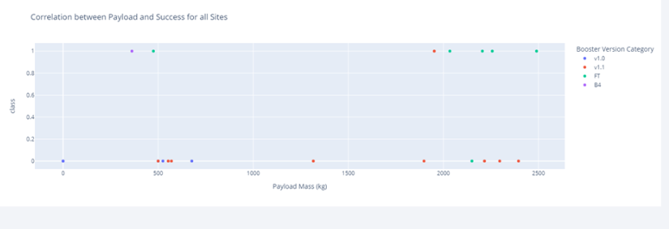
Payload vs launch outcome
Scatter plot for all sites with 2500,5000,10000 kg payload ranges

Slide 43
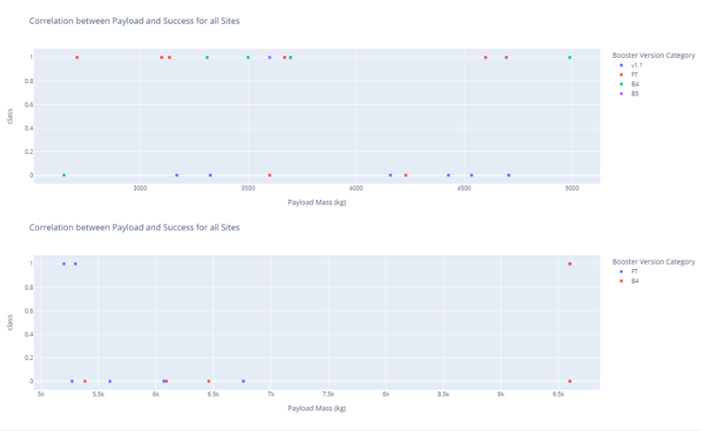
Payload vs launch outcome

Slide 44

Section 5

Slide 45
Classification Accuracy

Slide 46
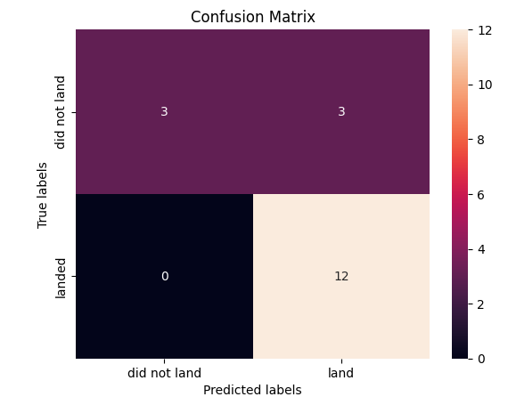
Confusion Matrix

Slide 47
Conclusions
All algorithm performs Similar
Using Machine learning model we can predict the landing and cost of launch

Slide 48


